Slide 1


SAP UI5 & FIORI with OData TRAINING
Anubhav Oberoy & Nishan Nainsukha
Day – 16

Slide 2

Agenda – Day 15
Client Side Query with OData

Slide 3
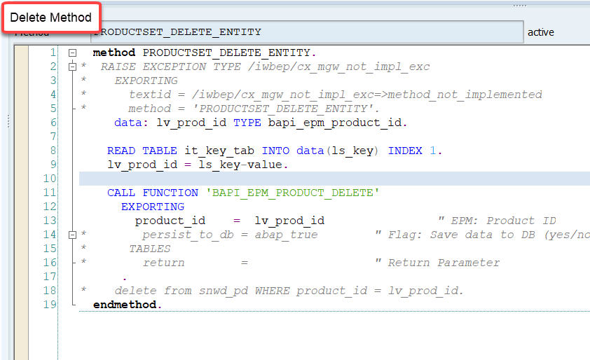
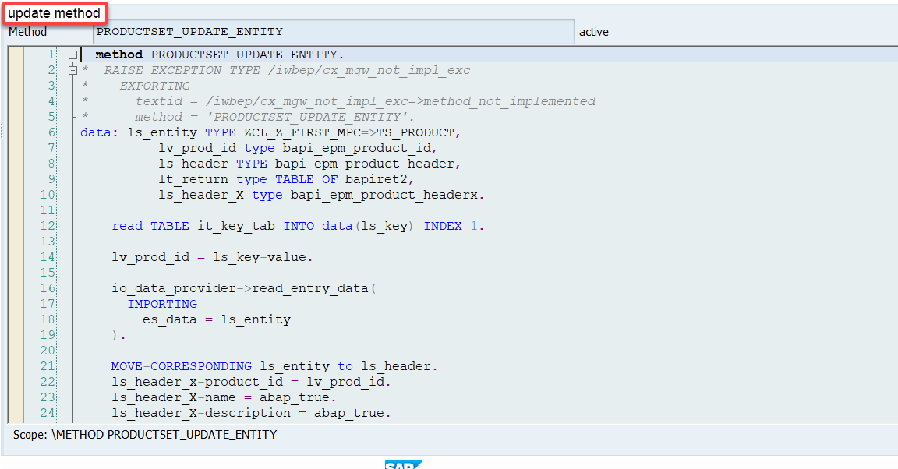
Implementing the delete and update method
We can implement the delete and update method in the cross-ponding dpc extension classes

Slide 4
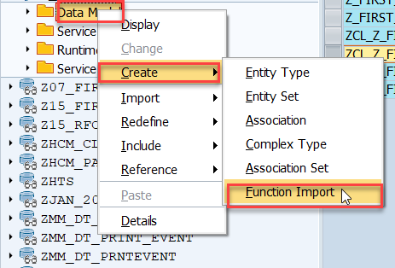
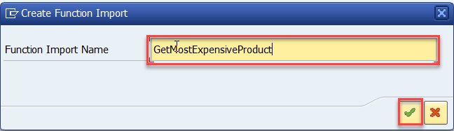
Function Import
At times, we need to implement the logic inside of OData which is not a direct CRUD operation e.g. calling a workflow, calling a BAPI which does some processing, Sending request to another server and can be invoked by the HTTP methods GET or POST .
For example: we can create the function import to GetMostExpensiveProduct in our Product set by the Category.
Step1: Right click the Data Model folder, and select Create and then select Function Import. Create Function Import dialog opens

Slide 5
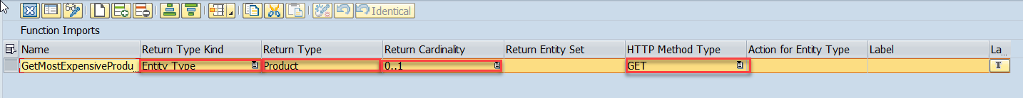
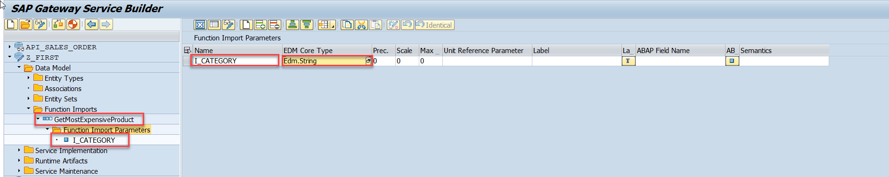
Function Import
Step2: Enter return type kind, return type, return cardinality & HTTP method Type
Step3: Giving function import parameters (I_CATEGORY)

Slide 6
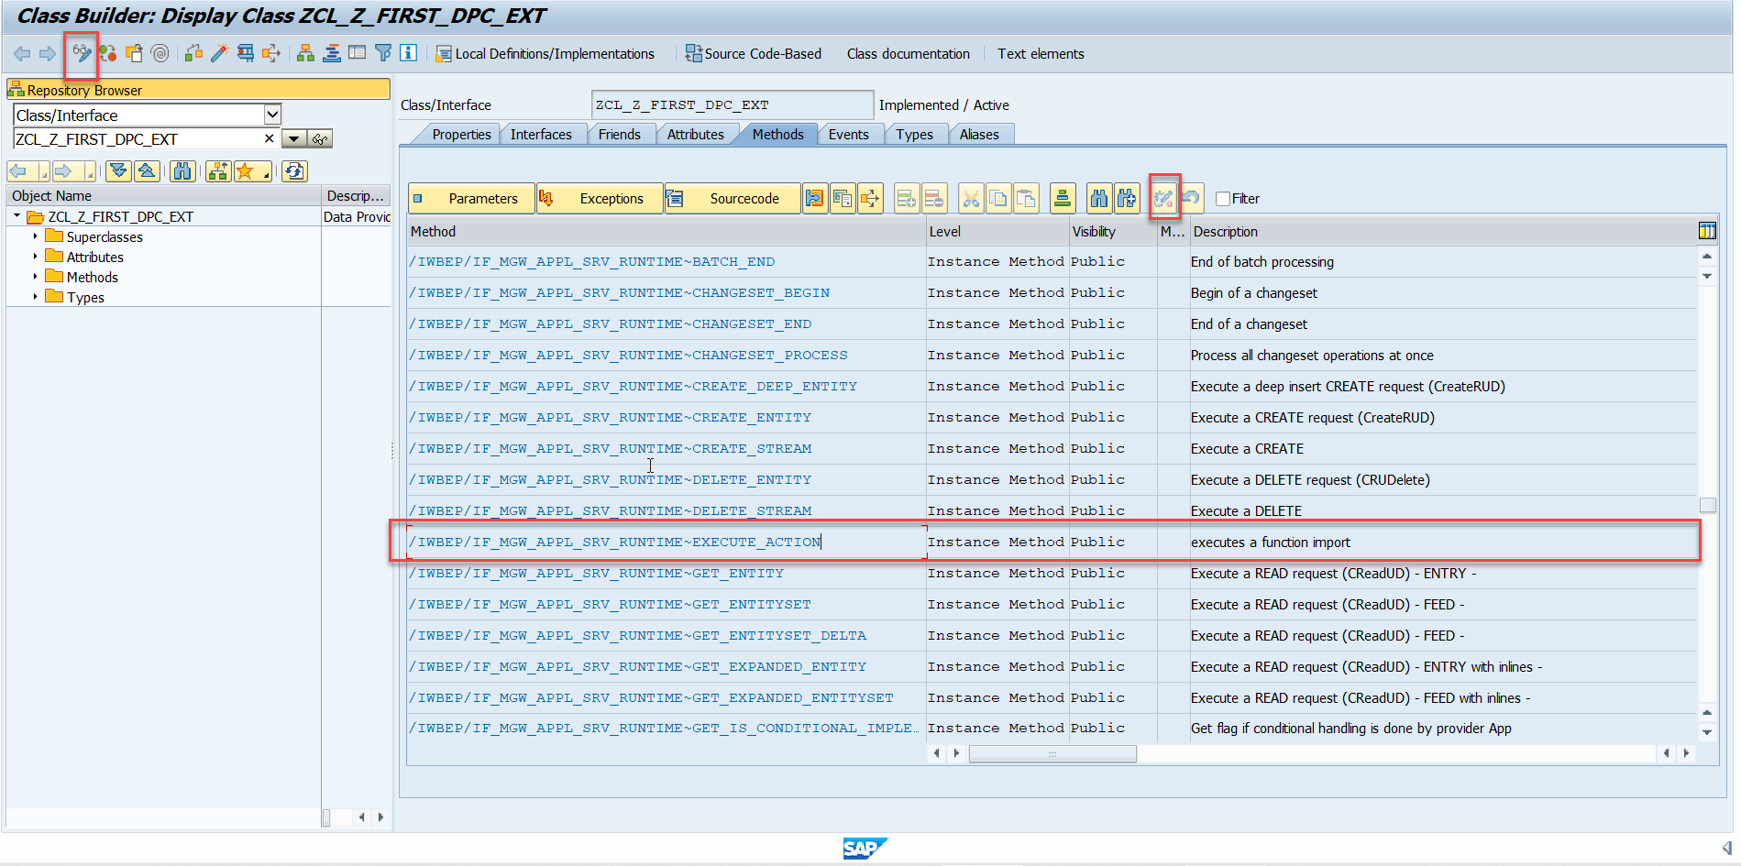
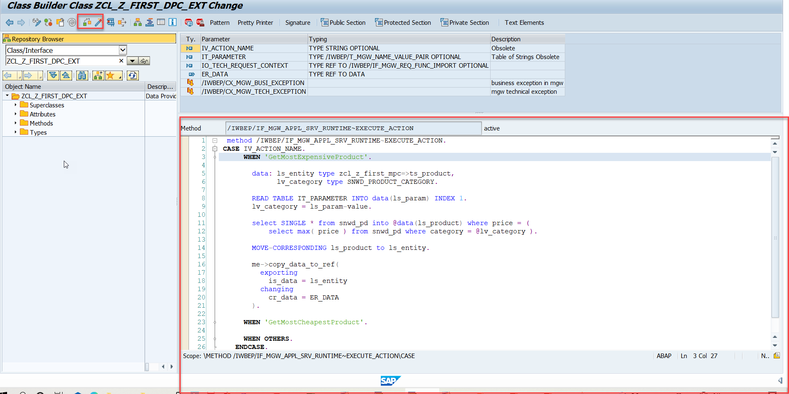
Function Import
Step4: Go to DPC Extension and search for the method--/IWBEP/IF_MGW_APPL_SRV_RUNTIME~EXECUTE_ACTION and redefine the class method

Slide 7

Exercise
Create a new Entity Set Supplier
Get the supplier header from BAPI_EPM_BP
Perform GetEntitySet and GetEntity

Slide 8
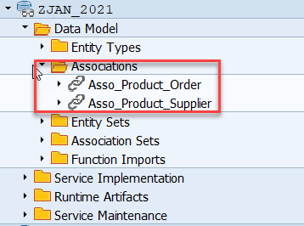
Association
Associations are relationship Between entities.
At database level we have foreign key relationship and same is reflected at odata level.
Once a association is created only then we can create navigation property.
Product
Supplier
1 relation 1
nav

Slide 9
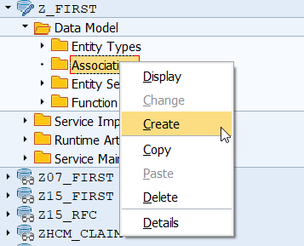
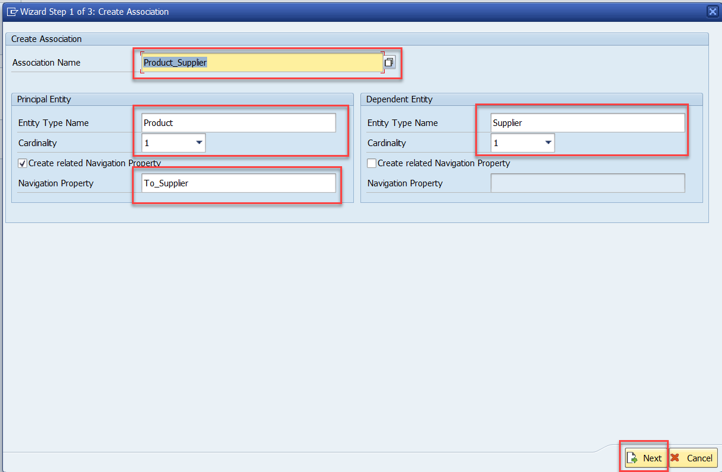
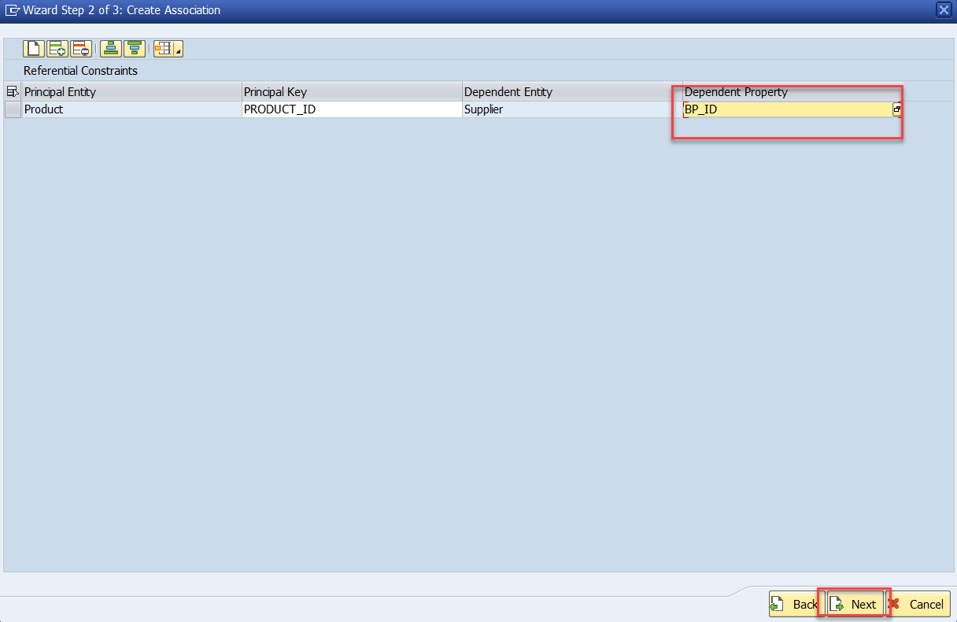
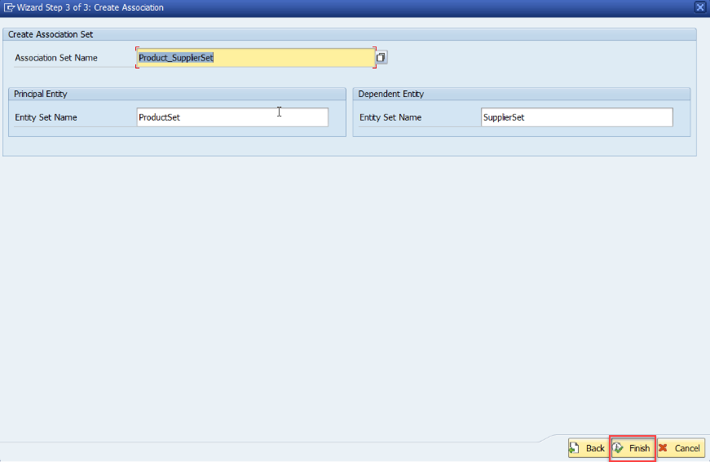
Association
Step:1 Right Click on Association and click on create

Slide 10
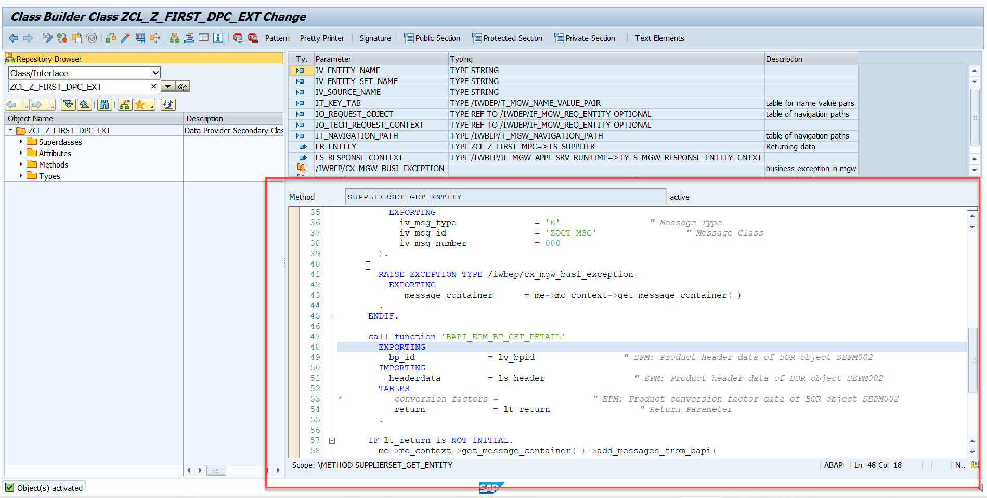
Association
Step2: Go to DPC extension and redefine the method for supplierSet GetEntity

Slide 11

End of Day 16

Slide 12

Questions

Slide 13

Anubhav Oberoy

Slide 14


We’re committed to empower you to be
Most Desirable Resource
through powerful training solutions.
We build the workforce of the future.
250+
Corporate Clients
30,000+
Learners Trained
25000+
Learners Placed
FREE WEBINARS
Sign up for free webinars with industry experts every fortnight!
Enroll Now!
Contact us today!
https://anubhavtrainings.com/

Slide 15




More from AnubhavTrainings.com

